Slide 1
Artificail Intelligence Twitter Dataset Sentimental Analysis
-- SENTIMENTAL ANALYSIS REPORT OF AI OPIONS ON TWITTER
Presented by：Vivian Kuang
Date: November 14th, 2023

Slide 2
Agenda
01
Introduction
CONTENT
PART ONE
02
Dataset and Sentimental Analysis
PART TWO
03
Report and Insights
PART THREE
04
Conclusion
PART FOUR

Slide 3
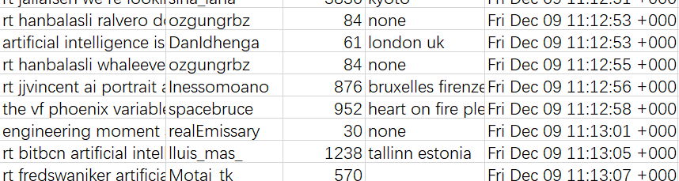
Twitter and AI dataset
X, formerly called Twitter, is an online social media and social networking service
AI dataset
1, tweet
2, user_name/screen_name
3, location
4, followers_count
5, created_at

Slide 4
Spark ML: Twitter Sentiment Analysis on the AI Twitter DS
1. Mount Twitter Sentiment Dataset
2. Text Cleaning Preprocessing
3. Feature Transformer:
A. Tokenizer
B. Tokenizer Stopword Removal
C. CountVectorizer (TF - Term Frequency)
D. TF-IDF Vectorization
4. Label Encoder
5. Model Training: Logistic Regression Classifier
6. Model Evaluation
7. Ngram Features
8. Putting a pipeline together
9. Assembly all and runing with train and test datasets
10. Save to the bucket

Slide 5
Conclusions and Next Steps
The results was not improved significantly with proper feature selection in this dataset
Tunning the parameters helps use the best of the algorithms
01
Social Media is mostly positive to the AI
02
LG classifier plays well in the dataset for SA analysis
03
Social Media with many followers such as forbes is positive and impactive over social medial

Slide 6
THANK YOU & QUESTIONS
THANKS FOR ALL
Vivian Kuang

